Slide 1
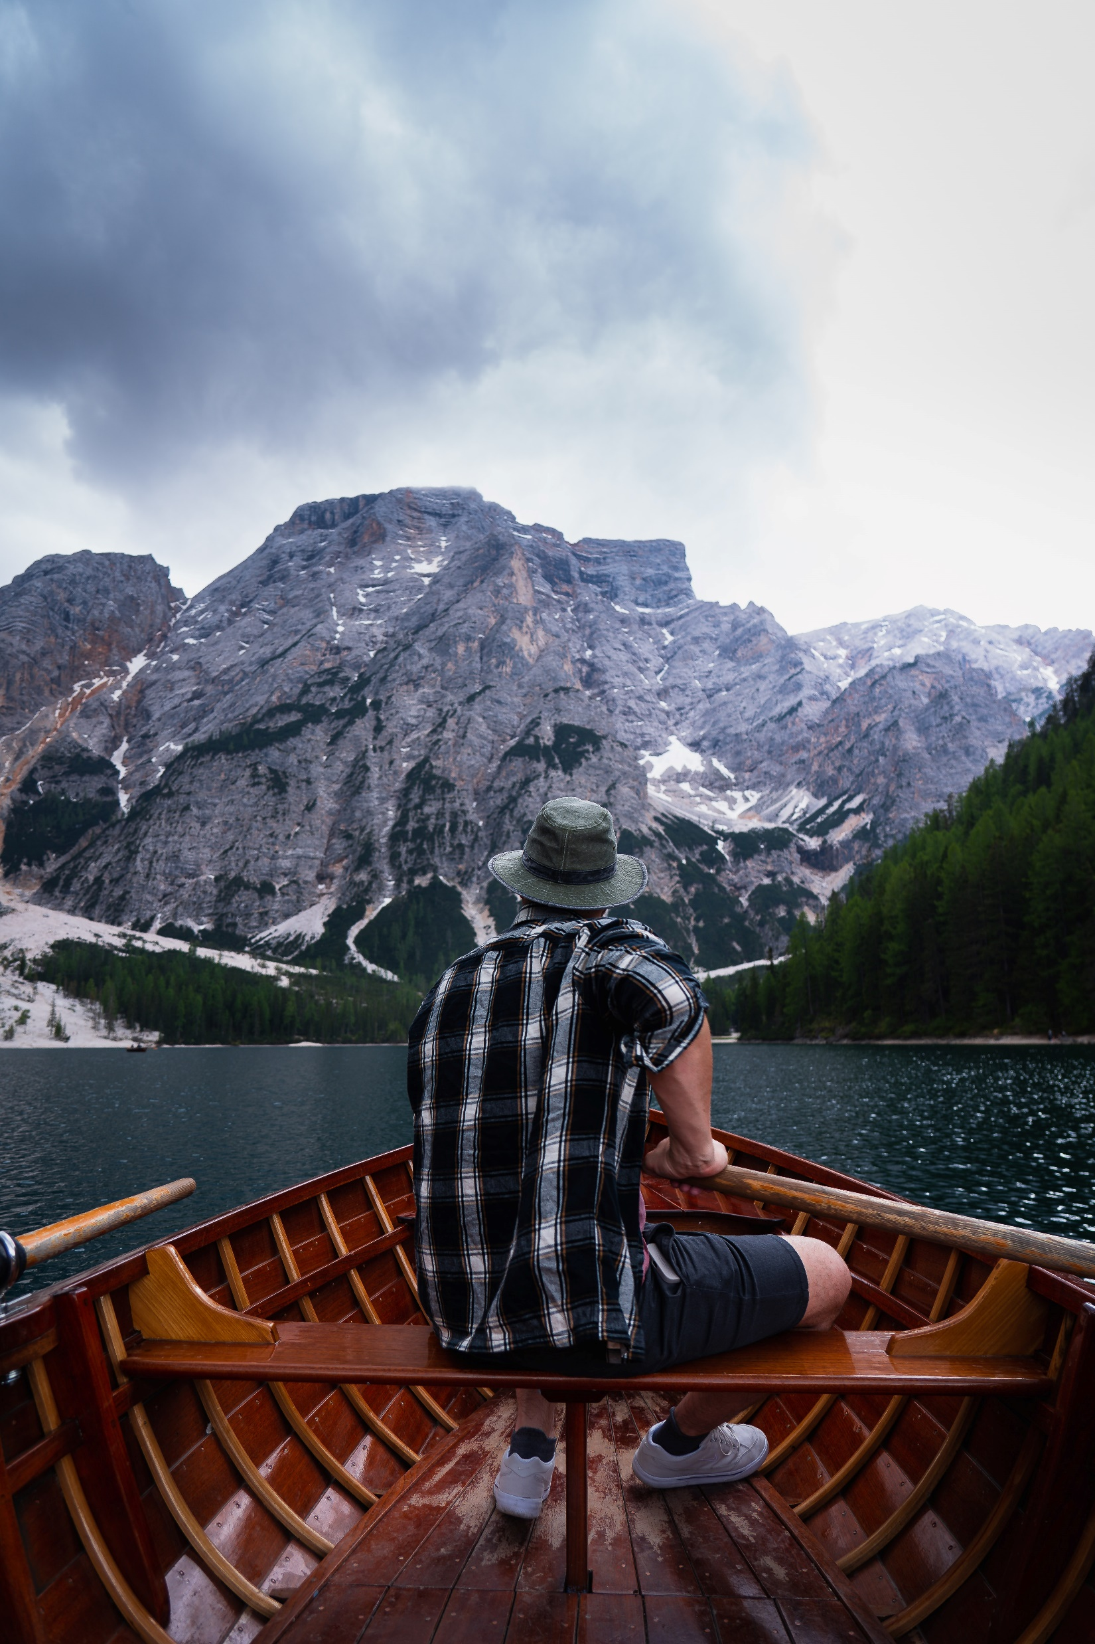

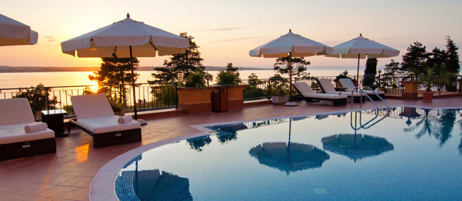
HOLIDAY
TOURS
Bokamoso Shogoe
Notes:
Photo by Julien Riedel on Unsplash

Slide 2
TABLE OF CONTENTS

Slide 3
LET US GO ON HOLIDAY
Plan Ahead: Research your destination, including local customs, weather, and activities. Make a rough itinerary but stay flexible. Budget Wisely: Set a budget for accommodation, food, activities, and souvenirs. Look for deals and discounts online. Pack Smart: Make a packing list tailored to your destination. Bring versatile clothing and essentials, but try to pack light. Stay Connected: Consider getting a local SIM card or an international plan to stay in touch and navigate easily. Stay Healthy: Pack a small first-aid kit, stay hydrated, and be mindful of local health recommendations. Try Local Cuisine: Don’t miss out on local foods! Explore street food and local restaurants for authentic experiences. Be Respectful: Learn a few phrases in the local language and be aware of cultural norms to show respect.
before
TIPS
HOLIDAY
after

Slide 4
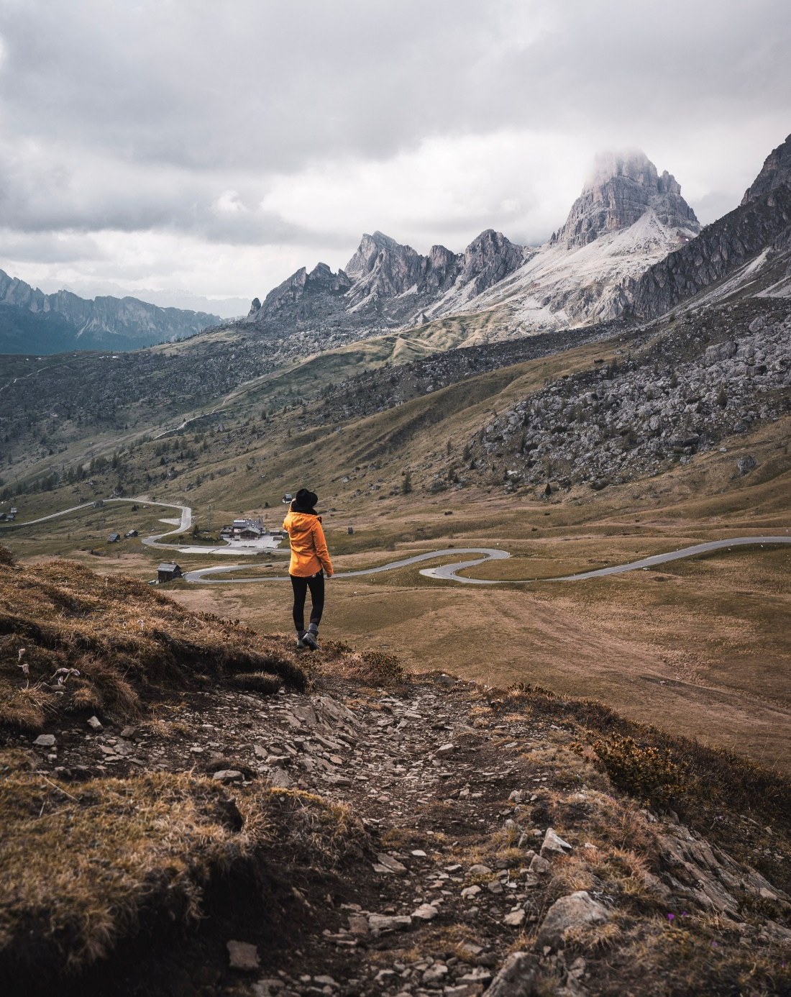
Budget for a
Holiday
Creating a budget for your holiday is essential to ensure a stress-free experience. Start by estimating costs for accommodation, meals, activities, and transportation, then add a buffer for unexpected expenses. Stick to your budget while allowing some flexibility for spontaneous adventures!
Traveling Costs
Accomodation Costs
Keep in mind that you must budget for train, flights and car rental.
Don’t forget accommodation – where will you be staying.
INFO
Notes:
Photo by Julien Riedel on Unsplash

Slide 5
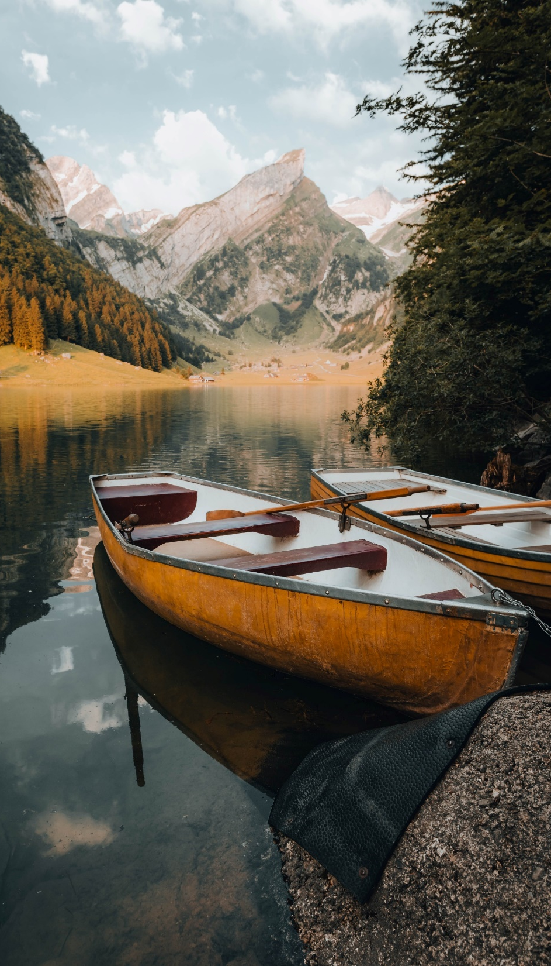
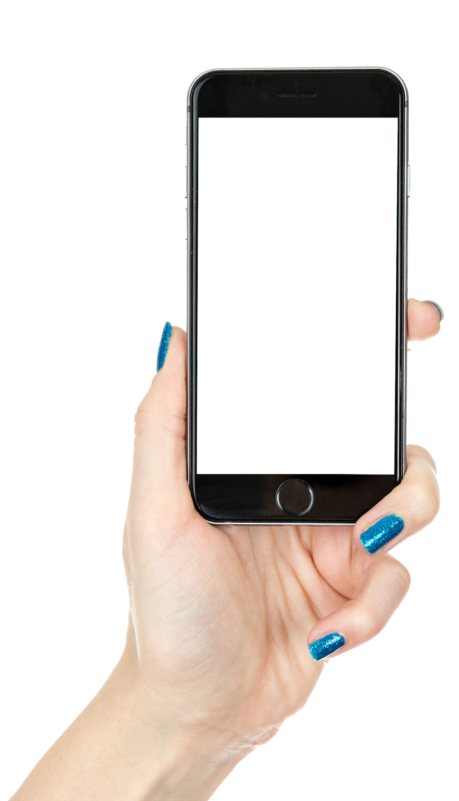
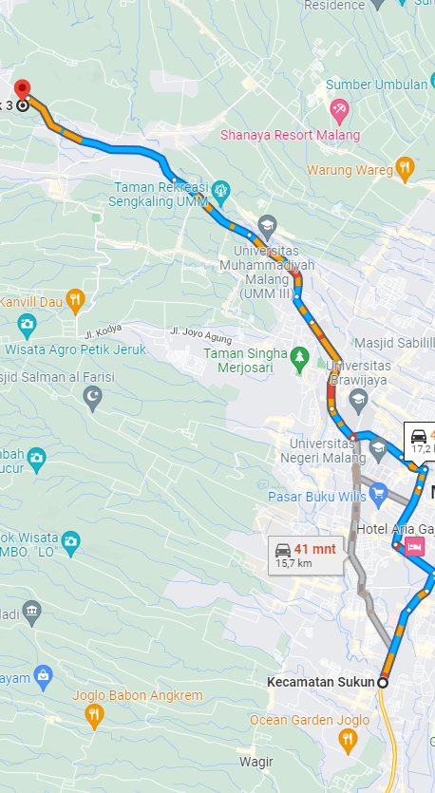
Find The Way
Use Google Maps to find your way around your traveling destinations. Make sure you have data or use local hotspots and WIFI services at your accommodation.
Accommodation
Sailing
Flights
Most hotels have WIFI services free of charge.
Sail boats use Netstar satellite to provide internet access.
All flights have WIFI access for a small fee.
Notes:
Photo by Alain Gehri on Unsplash

Slide 6
THANK
YOU
Notes:
Photo by Julien Riedel on Unsplash

Slide 7
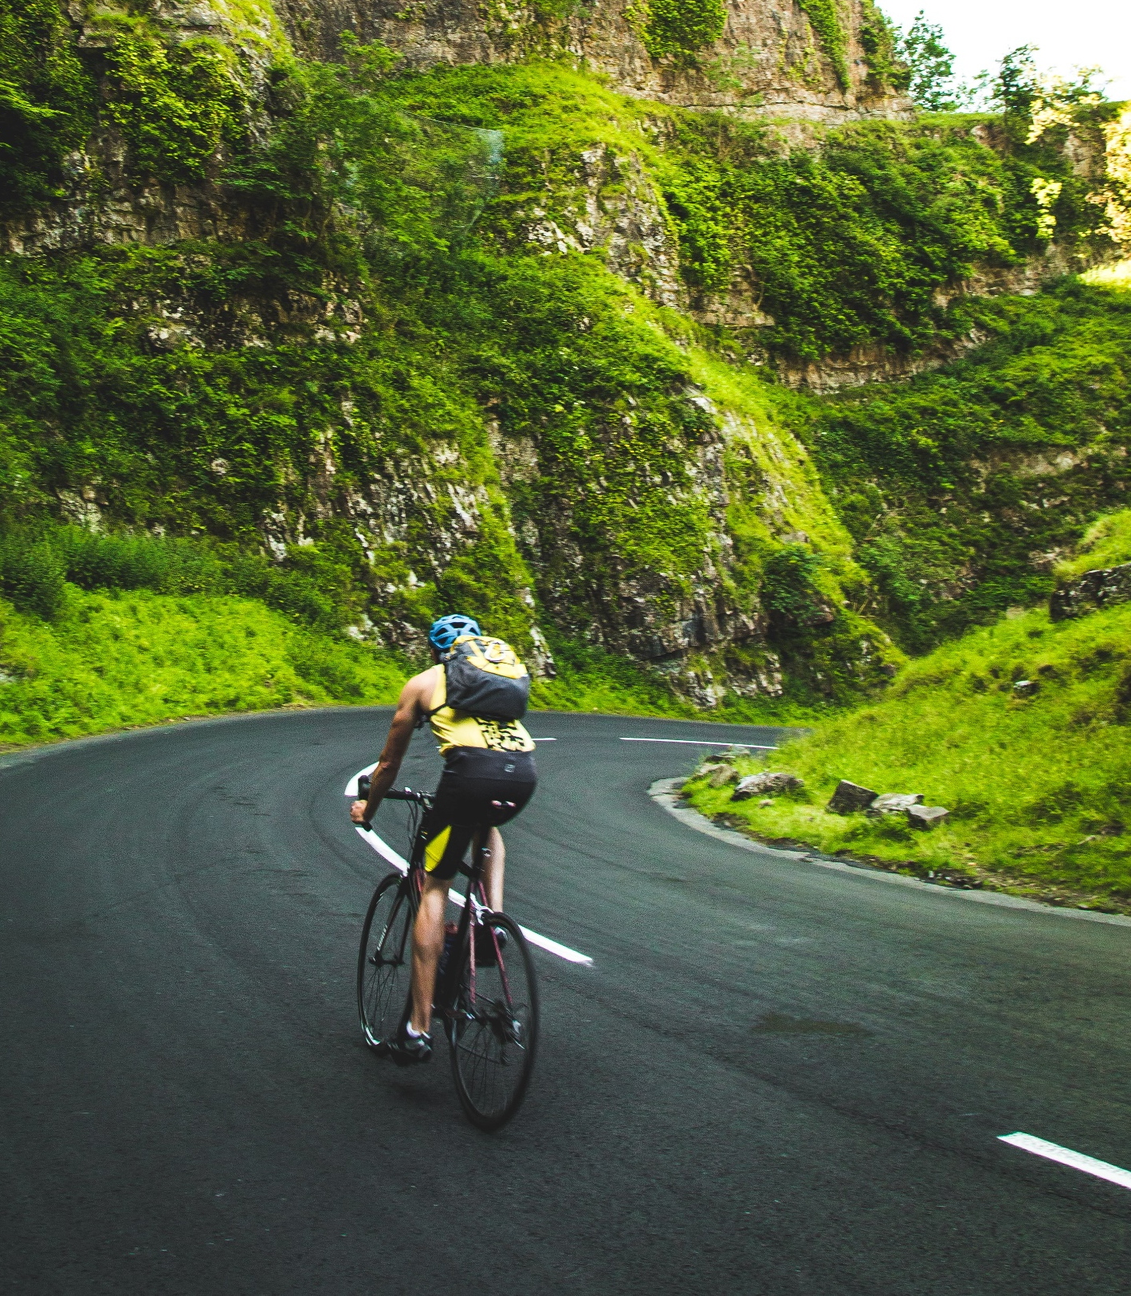
Most
Visited Place
Most Visited Place per Continent
Notes:
Photo by Paul Green on Unsplash

